Slide 1
Chapter 27 Binary Search Trees

Slide 2
Objectives
To design and implement a binary search tree (§27.2).
To represent binary trees using linked data structures (§27.2.1).
To search an element in binary search tree (§27.2.2).
To insert an element into a binary search tree (§27.2.3).
To traverse elements in a binary tree (§27.2.4).
To delete elements from a binary search tree (§27.3).
To display binary tree graphically (§27.4).
To create iterators for traversing a binary tree (§27.5).
To implement Huffman coding for compressing data using a binary tree (§27.6).

Slide 3
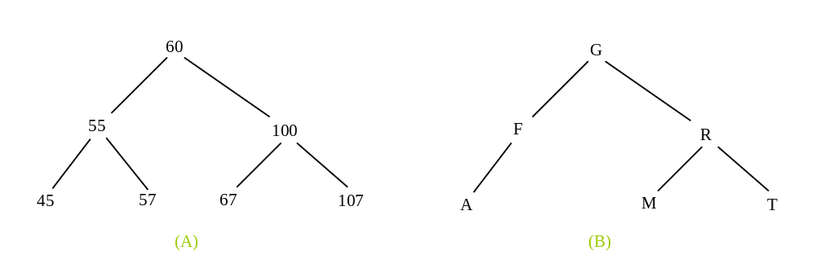
Binary Trees
A list, stack, or queue is a linear structure that consists of a sequence of elements. A binary tree is a hierarchical structure. It is either empty or consists of an element, called the root, and two distinct binary trees, called the left subtree and right subtree.

Slide 4
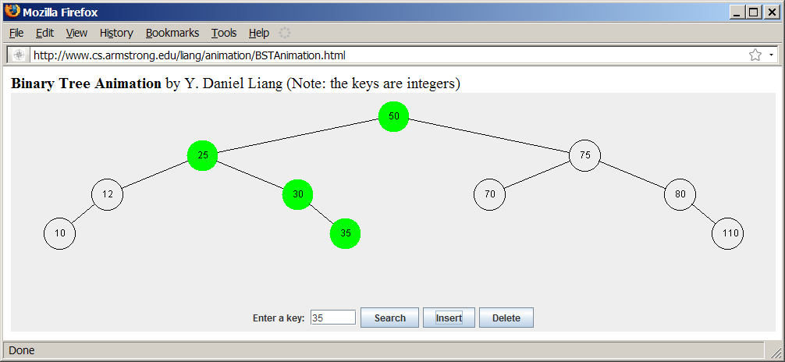
See How a Binary Tree Works
www.cs.armstrong.edu/liang/animation/BSTAnimation.html

Slide 5
Binary Tree Terms
The root of left (right) subtree of a node is called a left (right) child of the node.
A node without children is called a leaf.
A special type of binary tree called a binary search tree is often useful.
  A binary search tree (with no duplicate elements) has the property that for every node in the tree the value of any node in its left subtree is less than the value of the node and the value of any node in its right subtree is greater than the value of the node.
  The binary trees in slides 3 and 4 are all binary search trees. This section is concerned with binary search trees.

Slide 6
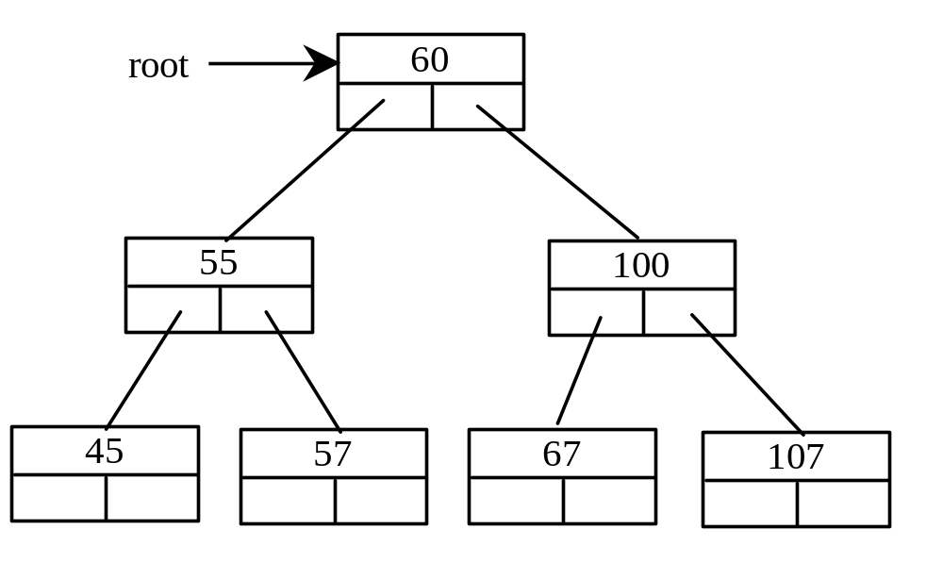
Representing Binary Trees
A binary tree can be represented using a set of linked nodes. Each node contains a value and two links named left and right that reference the left child and right child, respectively, as shown in the figure below.
class TreeNode<E> {
E element;
TreeNode<E> left;
TreeNode<E> right;
public TreeNode(E o) {
element = o;
}
}

Slide 7
Searching an Element in a Binary Tree
Start from the root and scan down from it until a match is found or arrive at an empty subtree.
Steps:
  If element is less than current element, assign left subtree to current
  If elment is greater than current element, assign right subtree to current
  If element is equal to current element, return true

Slide 8
Searching an Element in a Binary Tree
public boolean search(E element) {
TreeNode<E> current = root; // Start from the root
while (current != null)
if (element < current.element) {
current = current.left; // Go left
}
else if (element > current.element) {
current = current.right; // Go right
}
else // Element matches current.element
return true; // Element is found
return false; // Element is not in the tree
}

Slide 9
Inserting an Element to a Binary Tree
Locate the parent for the new node:
  If a binary tree is empty, create a root node with the new element. Otherwise, locate the parent node for the new element node.
  If the new element is less than the parent element, the node for the new element becomes the left child of the parent.
  If the new element is greater than the parent element, the node for the new element becomes the right child of the parent.

Slide 10
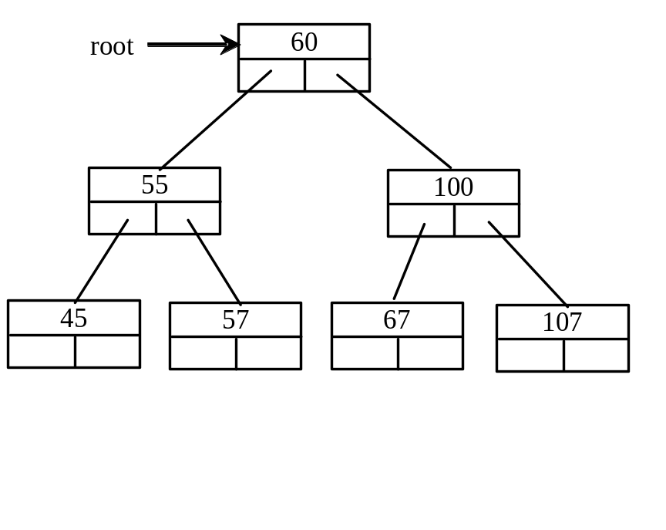
Inserting an Element to a Binary Tree
if (root == null)
root = new TreeNode(element);
else {
// Locate the parent node
current = root;
while (current != null)
if (element value < the value in current.element) {
parent = current;
current = current.left;
}
else if (element value > the value in current.element) {
parent = current;
current = current.right;
}
else
return false; // Duplicate node not inserted
// Create the new node and attach it to the parent node
if (element < parent.element)
parent.left = new TreeNode(elemenet);
else
parent.right = new TreeNode(elemenet);
return true; // Element inserted
}
Insert 101 into the following tree.

Slide 11
Trace Inserting 101 into the following tree
root is not null
if (root == null)
root = new TreeNode(element);
else {
// Locate the parent node
current = root;
while (current != null)
if (element value < the value in current.element) {
parent = current;
current = current.left;
}
else if (element value > the value in current.element) {
parent = current;
current = current.right;
}
else
return false; // Duplicate node not inserted
// Create the new node and attach it to the parent node
if (element < parent.element)
parent.left = new TreeNode(elemenet);
else
parent.right = new TreeNode(elemenet);
return true; // Element inserted
}
Insert 101 into the following tree.

Slide 12
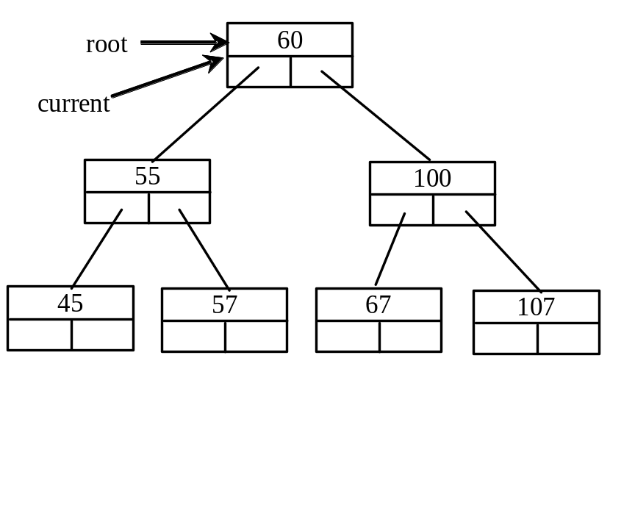
Trace Inserting 101 into the following tree, cont.
if (root == null)
root = new TreeNode(element);
else {
// Locate the parent node
current = root;
while (current != null)
if (element value < the value in current.element) {
parent = current;
current = current.left;
}
else if (element value > the value in current.element) {
parent = current;
current = current.right;
}
else
return false; // Duplicate node not inserted
// Create the new node and attach it to the parent node
if (element < parent.element)
parent.left = new TreeNode(elemenet);
else
parent.right = new TreeNode(elemenet);
return true; // Element inserted
}
Insert 101 into the following tree.

Slide 13
Trace Inserting 101 into the following tree, cont.
if (root == null)
root = new TreeNode(element);
else {
// Locate the parent node
current = root;
while (current != null)
if (element value < the value in current.element) {
parent = current;
current = current.left;
}
else if (element value > the value in current.element) {
parent = current;
current = current.right;
}
else
return false; // Duplicate node not inserted
// Create the new node and attach it to the parent node
if (element < parent.element)
parent.left = new TreeNode(elemenet);
else
parent.right = new TreeNode(elemenet);
return true; // Element inserted
}
Insert 101 into the following tree.
current is not null

Slide 14
Trace Inserting 101 into the following tree, cont.
if (root == null)
root = new TreeNode(element);
else {
// Locate the parent node
current = root;
while (current != null)
if (element value < the value in current.element) {
parent = current;
current = current.left;
}
else if (element value > the value in current.element) {
parent = current;
current = current.right;
}
else
return false; // Duplicate node not inserted
// Create the new node and attach it to the parent node
if (element < parent.element)
parent.left = new TreeNode(elemenet);
else
parent.right = new TreeNode(elemenet);
return true; // Element inserted
}
Insert 101 into the following tree.
101 < 60 => false

Slide 15
Trace Inserting 101 into the following tree, cont.
if (root == null)
root = new TreeNode(element);
else {
// Locate the parent node
current = root;
while (current != null)
if (element value < the value in current.element) {
parent = current;
current = current.left;
}
else if (element value > the value in current.element) {
parent = current;
current = current.right;
}
else
return false; // Duplicate node not inserted
// Create the new node and attach it to the parent node
if (element < parent.element)
parent.left = new TreeNode(elemenet);
else
parent.right = new TreeNode(elemenet);
return true; // Element inserted
}
Insert 101 into the following tree.
101 > 60 => true

Slide 16
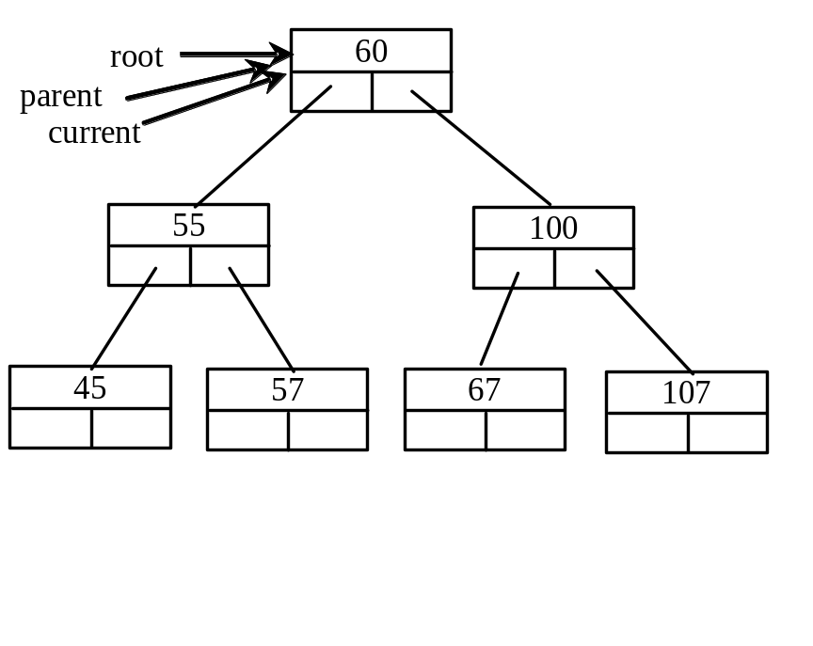
Trace Inserting 101 into the following tree, cont.
if (root == null)
root = new TreeNode(element);
else {
// Locate the parent node
current = root;
while (current != null)
if (element value < the value in current.element) {
parent = current;
current = current.left;
}
else if (element value > the value in current.element) {
parent = current;
current = current.right;
}
else
return false; // Duplicate node not inserted
// Create the new node and attach it to the parent node
if (element < parent.element)
parent.left = new TreeNode(elemenet);
else
parent.right = new TreeNode(elemenet);
return true; // Element inserted
}
Insert 101 into the following tree.
101 > 60 => true

Slide 17
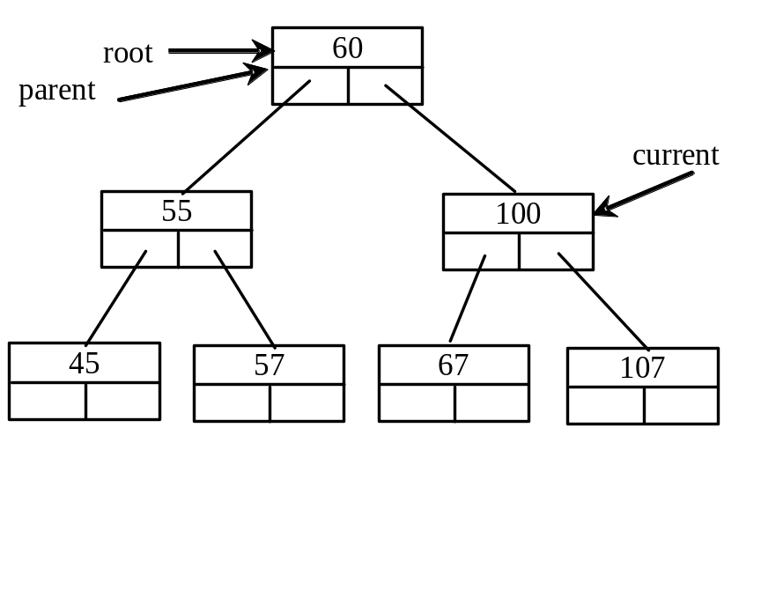
Trace Inserting 101 into the following tree, cont.
if (root == null)
root = new TreeNode(element);
else {
// Locate the parent node
current = root;
while (current != null)
if (element value < the value in current.element) {
parent = current;
current = current.left;
}
else if (element value > the value in current.element) {
parent = current;
current = current.right;
}
else
return false; // Duplicate node not inserted
// Create the new node and attach it to the parent node
if (element < parent.element)
parent.left = new TreeNode(elemenet);
else
parent.right = new TreeNode(elemenet);
return true; // Element inserted
}
Insert 101 into the following tree.
101 > 60 => true

Slide 18
Trace Inserting 101 into the following tree, cont.
if (root == null)
root = new TreeNode(element);
else {
// Locate the parent node
current = root;
while (current != null)
if (element value < the value in current.element) {
parent = current;
current = current.left;
}
else if (element value > the value in current.element) {
parent = current;
current = current.right;
}
else
return false; // Duplicate node not inserted
// Create the new node and attach it to the parent node
if (element < parent.element)
parent.left = new TreeNode(elemenet);
else
parent.right = new TreeNode(elemenet);
return true; // Element inserted
}
Insert 101 into the following tree.
current is not null
101 > 60 => true

Slide 19
Trace Inserting 101 into the following tree, cont.
if (root == null)
root = new TreeNode(element);
else {
// Locate the parent node
current = root;
while (current != null)
if (element value < the value in current.element) {
parent = current;
current = current.left;
}
else if (element value > the value in current.element) {
parent = current;
current = current.right;
}
else
return false; // Duplicate node not inserted
// Create the new node and attach it to the parent node
if (element < parent.element)
parent.left = new TreeNode(elemenet);
else
parent.right = new TreeNode(elemenet);
return true; // Element inserted
}
Insert 101 into the following tree.
101 < 100 => false

Slide 20
Trace Inserting 101 into the following tree, cont.
if (root == null)
root = new TreeNode(element);
else {
// Locate the parent node
current = root;
while (current != null)
if (element value < the value in current.element) {
parent = current;
current = current.left;
}
else if (element value > the value in current.element) {
parent = current;
current = current.right;
}
else
return false; // Duplicate node not inserted
// Create the new node and attach it to the parent node
if (element < parent.element)
parent.left = new TreeNode(elemenet);
else
parent.right = new TreeNode(elemenet);
return true; // Element inserted
}
Insert 101 into the following tree.
101 > 100 => true

Slide 21
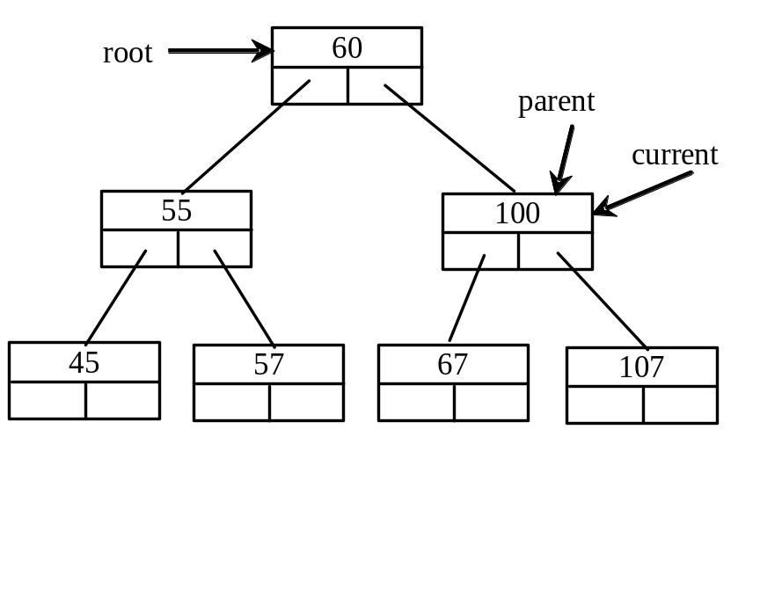
Trace Inserting 101 into the following tree, cont.
if (root == null)
root = new TreeNode(element);
else {
// Locate the parent node
current = root;
while (current != null)
if (element value < the value in current.element) {
parent = current;
current = current.left;
}
else if (element value > the value in current.element) {
parent = current;
current = current.right;
}
else
return false; // Duplicate node not inserted
// Create the new node and attach it to the parent node
if (element < parent.element)
parent.left = new TreeNode(elemenet);
else
parent.right = new TreeNode(elemenet);
return true; // Element inserted
}
Insert 101 into the following tree.
101 > 100 => true

Slide 22
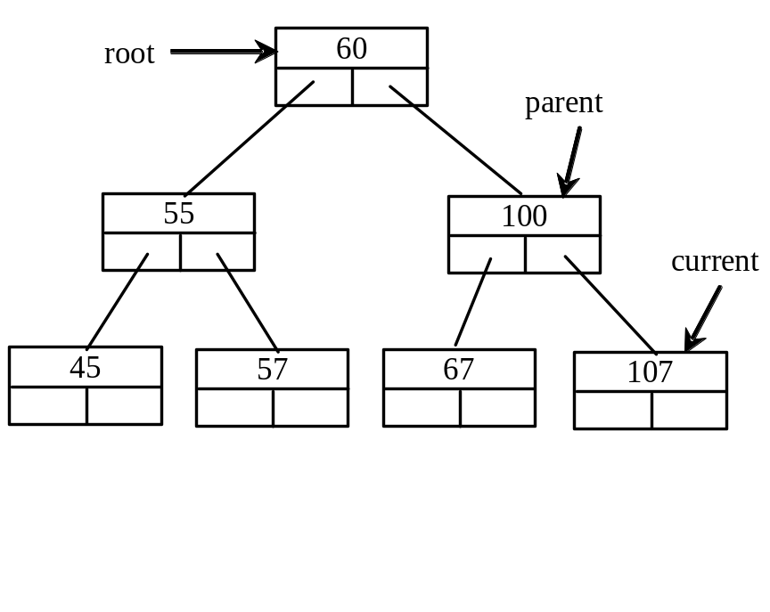
Trace Inserting 101 into the following tree, cont.
if (root == null)
root = new TreeNode(element);
else {
// Locate the parent node
current = root;
while (current != null)
if (element value < the value in current.element) {
parent = current;
current = current.left;
}
else if (element value > the value in current.element) {
parent = current;
current = current.right;
}
else
return false; // Duplicate node not inserted
// Create the new node and attach it to the parent node
if (element < parent.element)
parent.left = new TreeNode(elemenet);
else
parent.right = new TreeNode(elemenet);
return true; // Element inserted
}
Insert 101 into the following tree.
101 > 100 => true

Slide 23
Trace Inserting 101 into the following tree, cont.
if (root == null)
root = new TreeNode(element);
else {
// Locate the parent node
current = root;
while (current != null)
if (element value < the value in current.element) {
parent = current;
current = current.left;
}
else if (element value > the value in current.element) {
parent = current;
current = current.right;
}
else
return false; // Duplicate node not inserted
// Create the new node and attach it to the parent node
if (element < parent.element)
parent.left = new TreeNode(elemenet);
else
parent.right = new TreeNode(elemenet);
return true; // Element inserted
}
Insert 101 into the following tree.
current is not null

Slide 24
Trace Inserting 101 into the following tree, cont.
if (root == null)
root = new TreeNode(element);
else {
// Locate the parent node
current = root;
while (current != null)
if (element value < the value in current.element) {
parent = current;
current = current.left;
}
else if (element value > the value in current.element) {
parent = current;
current = current.right;
}
else
return false; // Duplicate node not inserted
// Create the new node and attach it to the parent node
if (element < parent.element)
parent.left = new TreeNode(elemenet);
else
parent.right = new TreeNode(elemenet);
return true; // Element inserted
}
Insert 101 into the following tree.
101 < 107 => true

Slide 25
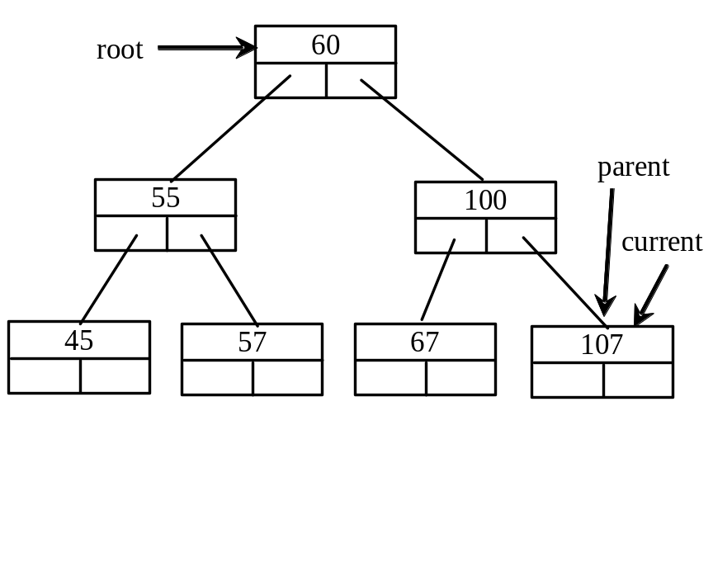
Trace Inserting 101 into the following tree, cont.
if (root == null)
root = new TreeNode(element);
else {
// Locate the parent node
current = root;
while (current != null)
if (element value < the value in current.element) {
parent = current;
current = current.left;
}
else if (element value > the value in current.element) {
parent = current;
current = current.right;
}
else
return false; // Duplicate node not inserted
// Create the new node and attach it to the parent node
if (element < parent.element)
parent.left = new TreeNode(elemenet);
else
parent.right = new TreeNode(elemenet);
return true; // Element inserted
}
Insert 101 into the following tree.
101 < 107 => true

Slide 26
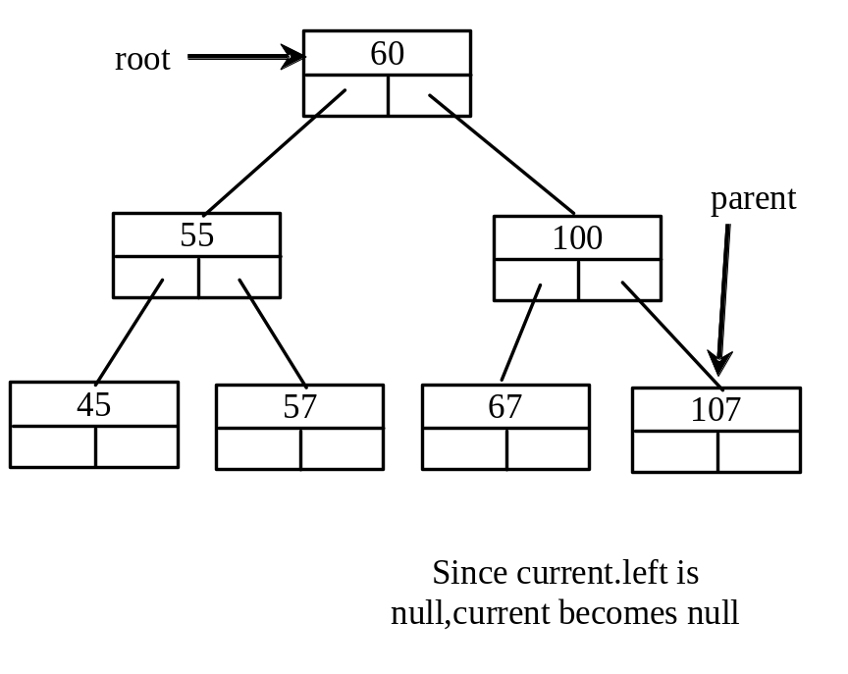
Trace Inserting 101 into the following tree, cont.
if (root == null)
root = new TreeNode(element);
else {
// Locate the parent node
current = root;
while (current != null)
if (element value < the value in current.element) {
parent = current;
current = current.left;
}
else if (element value > the value in current.element) {
parent = current;
current = current.right;
}
else
return false; // Duplicate node not inserted
// Create the new node and attach it to the parent node
if (element < parent.element)
parent.left = new TreeNode(elemenet);
else
parent.right = new TreeNode(elemenet);
return true; // Element inserted
}
Insert 101 into the following tree.
101 < 107 => true

Slide 27
Trace Inserting 101 into the following tree, cont.
if (root == null)
root = new TreeNode(element);
else {
// Locate the parent node
current = root;
while (current != null)
if (element value < the value in current.element) {
parent = current;
current = current.left;
}
else if (element value > the value in current.element) {
parent = current;
current = current.right;
}
else
return false; // Duplicate node not inserted
// Create the new node and attach it to the parent node
if (element < parent.element)
parent.left = new TreeNode(elemenet);
else
parent.right = new TreeNode(elemenet);
return true; // Element inserted
}
Insert 101 into the following tree.
current is null now

Slide 28
Trace Inserting 101 into the following tree, cont.
if (root == null)
root = new TreeNode(element);
else {
// Locate the parent node
current = root;
while (current != null)
if (element value < the value in current.element) {
parent = current;
current = current.left;
}
else if (element value > the value in current.element) {
parent = current;
current = current.right;
}
else
return false; // Duplicate node not inserted
// Create the new node and attach it to the parent node
if (element < parent.element)
parent.left = new TreeNode(elemenet);
else
parent.right = new TreeNode(elemenet);
return true; // Element inserted
}
Insert 101 into the following tree.
101 < 107=> true

Slide 29
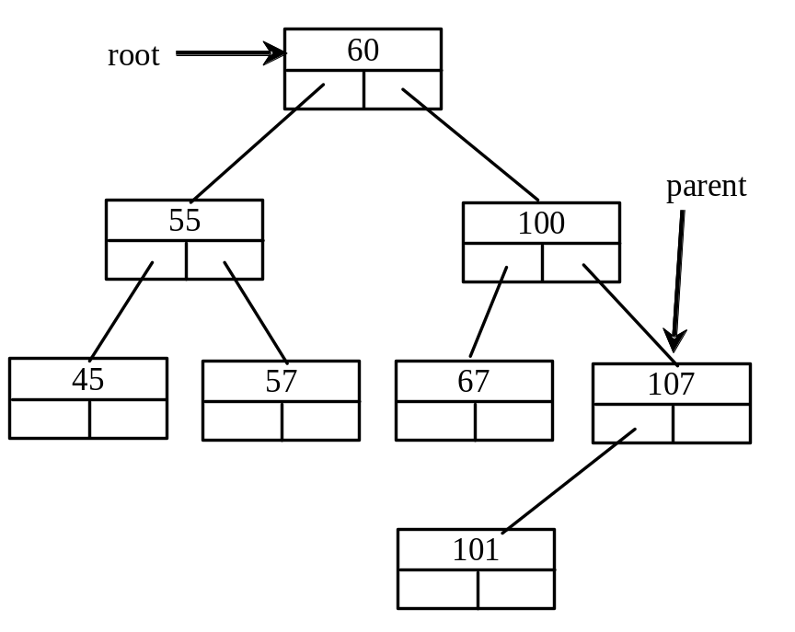
Trace Inserting 101 into the following tree, cont.
if (root == null)
root = new TreeNode(element);
else {
// Locate the parent node
current = root;
while (current != null)
if (element value < the value in current.element) {
parent = current;
current = current.left;
}
else if (element value > the value in current.element) {
parent = current;
current = current.right;
}
else
return false; // Duplicate node not inserted
// Create the new node and attach it to the parent node
if (element < parent.element)
parent.left = new TreeNode(elemenet);
else
parent.right = new TreeNode(elemenet);
return true; // Element inserted
}
Insert 101 into the following tree.
101 < 107=> true

Slide 30
Trace Inserting 101 into the following tree, cont.
if (root == null)
root = new TreeNode(element);
else {
// Locate the parent node
current = root;
while (current != null)
if (element value < the value in current.element) {
parent = current;
current = current.left;
}
else if (element value > the value in current.element) {
parent = current;
current = current.right;
}
else
return false; // Duplicate node not inserted
// Create the new node and attach it to the parent node
if (element < parent.element)
parent.left = new TreeNode(elemenet);
else
parent.right = new TreeNode(elemenet);
return true; // Element inserted
}
Insert 101 into the following tree.

Slide 31
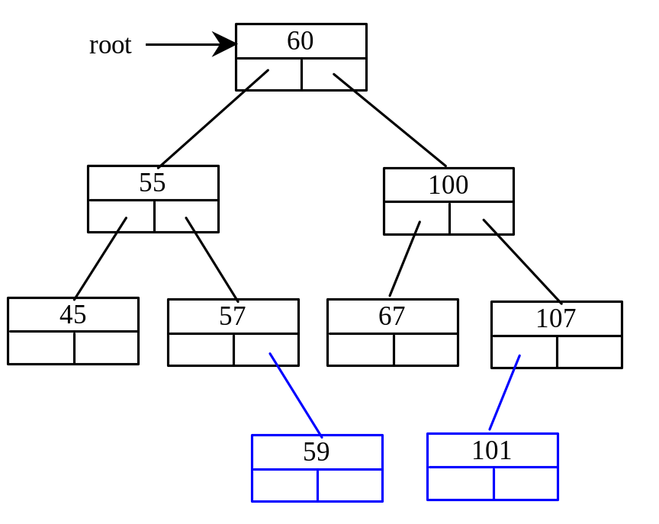
Inserting 59 into the Tree
if (root == null)
root = new TreeNode(element);
else {
// Locate the parent node
current = root;
while (current != null)
if (element value < the value in current.element) {
parent = current;
current = current.left;
}
else if (element value > the value in current.element) {
parent = current;
current = current.right;
}
else
return false; // Duplicate node not inserted
// Create the new node and attach it to the parent node
if (element < parent.element)
parent.left = new TreeNode(elemenet);
else
parent.right = new TreeNode(elemenet);
return true; // Element inserted
}

Slide 32
Tree Traversal
Tree traversal is the process of visiting each node in the tree exactly once. There are several ways to traverse a tree. This section presents inorder, preorder, postorder, depth-first, and breadth-first traversals.
The inorder traversal is to visit the left subtree of the current node first recursively, then the current node itself, and finally the right subtree of the current node recursively.
The postorder traversal is to visit the left subtree of the current node first, then the right subtree of the current node, and finally the current node itself.

Slide 33
Tree Traversal, cont.
The preorder traversal is to visit the current node first, then
the left subtree of the current node recursively, and finally the right subtree of the current node recursively.
The breadth-first traversal is to visit the nodes level by level. First visit the root, then all children of the root from left to right, then grandchildren of the root from left to right, and so on.

Slide 34
For example, in the tree given above,
inorder : 45 55 57 59 60 67 100 101 107
postorder : 45 59 57 55 67 101 107 100 60
preorder : 60 55 45 57 59 100 67 107 101
breadth-first : 60 55 100 45 57 67 107 59 101.

Slide 35
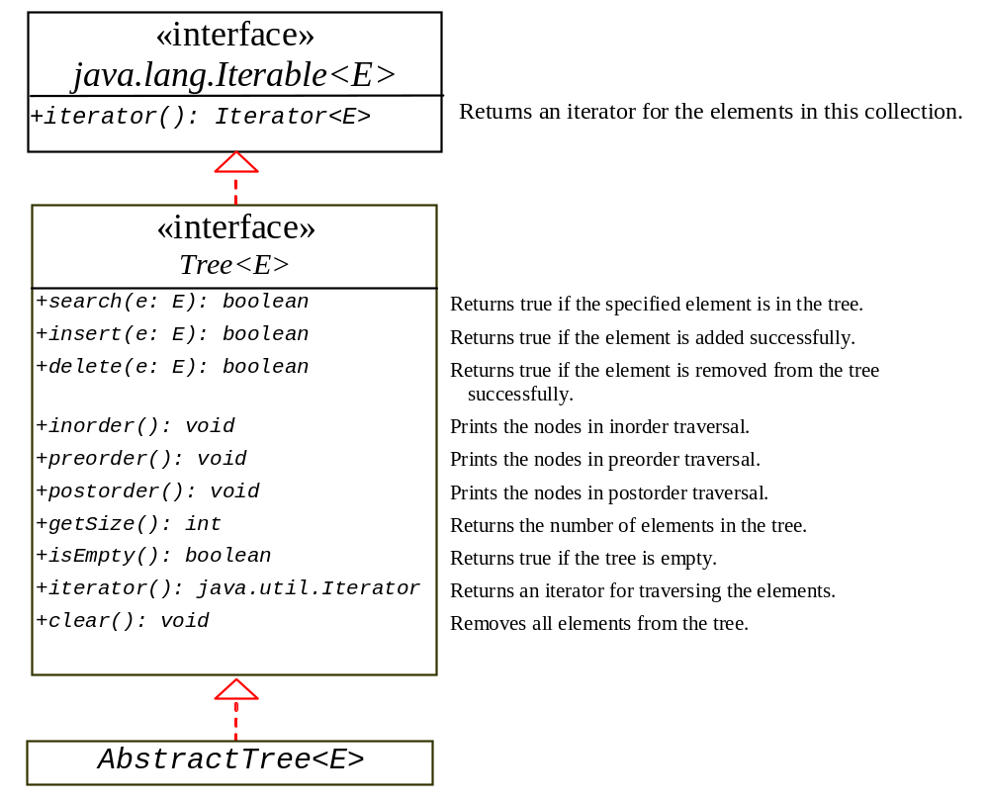
The Tree Interface
The Tree interface defines common operations for trees, and the AbstractTree class partially implements Tree.
Tree
AbstractTree

Slide 36
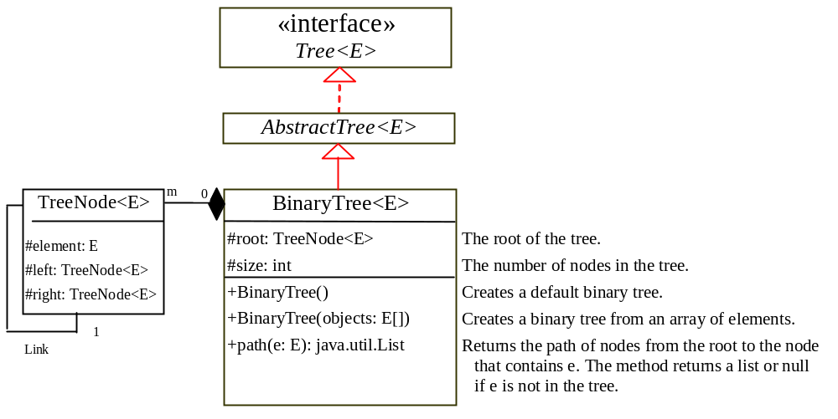
The BinaryTree Class
Let’s define the binary tree class, named BinaryTree with A concrete BinaryTree class can be defined to extend AbstractTree.
BinaryTree

Slide 37
Example: Using Binary Trees
Write a program that creates a binary tree using BinaryTree. Add strings into the binary tree and traverse the tree in inorder, postorder, and preorder.
TestBinaryTree
Run

Slide 38
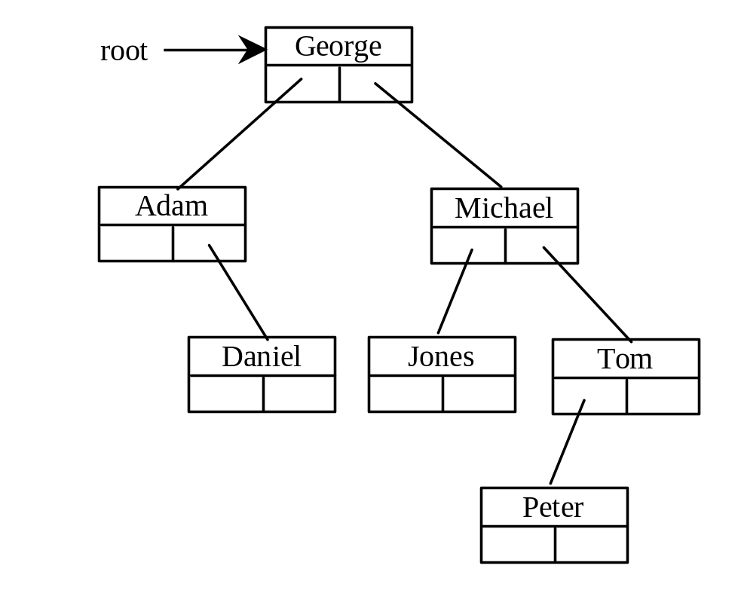
Tree After Insertions
Inorder: Adam, Daniel George, Jones, Michael, Peter, Tom
Postorder: Daniel Adam, Jones, Peter, Tom, Michael, George
Preorder: George, Adam, Daniel, Michael, Jones, Tom, Peter

Slide 39
Deleting Elements in a Binary Search Tree
To delete an element from a binary tree, you need to first locate the node that contains the element and also its parent node
Let current point to the node that contains the element in the binary tree and parent point to the parent of the current node. The current node may be a left child or a right child of the parent node.
There are two cases to consider:

Slide 40
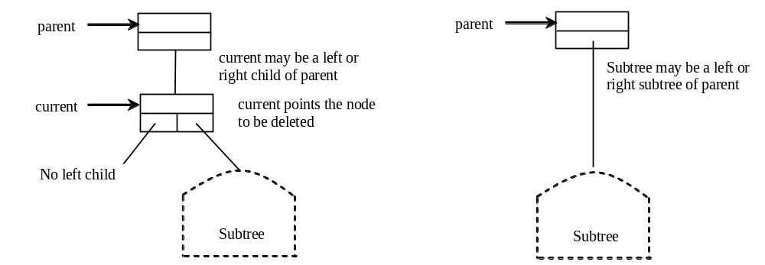
Deleting Elements in a Binary Search Tree
Case 1: The current node does not have a left child. Simply connect the parent with the right child of the current node, as shown in the figure below:

Slide 41
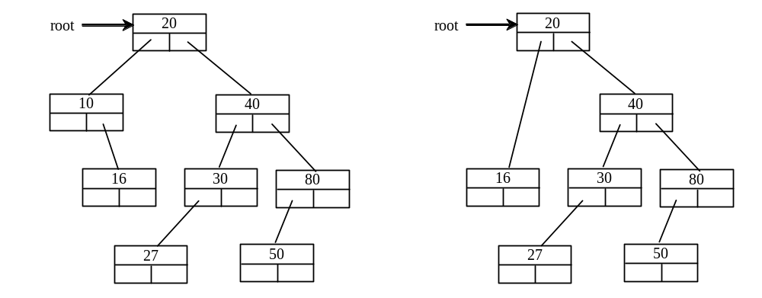
Deleting Elements in a Binary Search Tree
For example, to delete node 10 in the figure below. Connect the parent of node 10 with the right child of node 10.

Slide 42
Deleting Elements in a Binary Search Tree
Case 2: Refer to the figures in the next slide, the current node has a left child.
  Let rightMost point to the node that contains the largest element in the left subtree of the current node and parentOfRightMost point to the parent node of the rightMost node, as shown in the left figure. Note that the rightMost node cannot have a right child, but may have a left child.
  Replace the element value in the current node with the one in the rightMost node, connect the parentOfRightMost node with the left child of the rightMost node, and delete the rightMost node, as shown in the right figure.

Slide 43
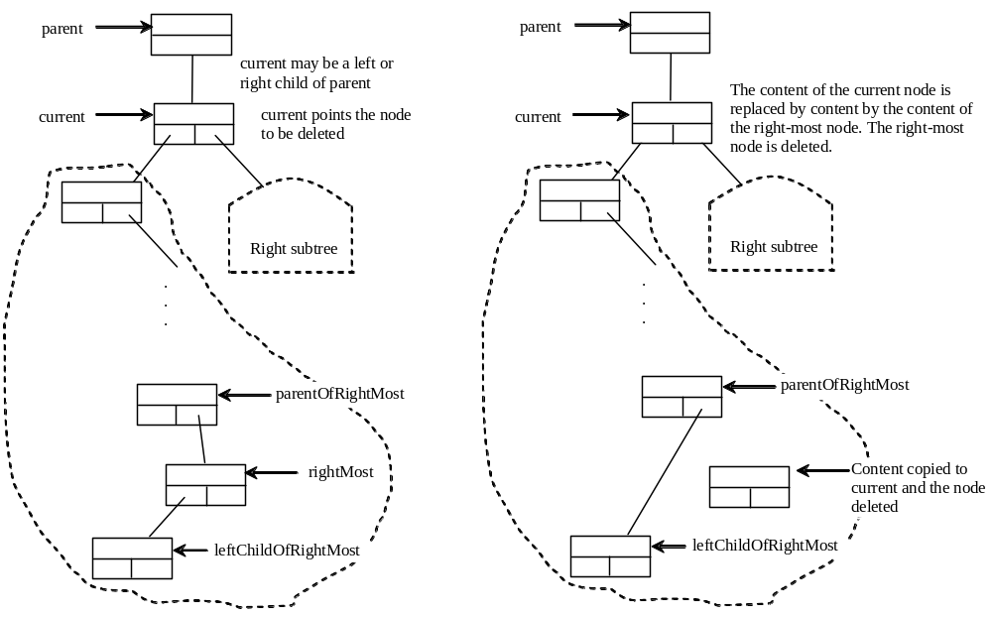
Deleting Elements in a Binary Search Tree
Case 2 diagram

Slide 44
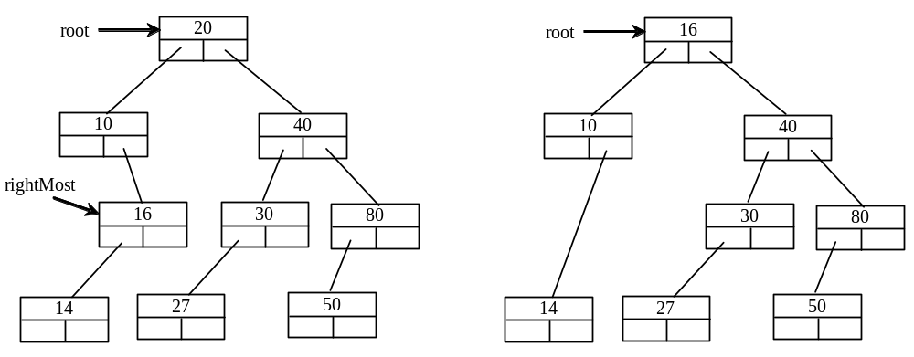
Deleting Elements in a Binary Search Tree
Case 2 example, delete 20

Slide 45
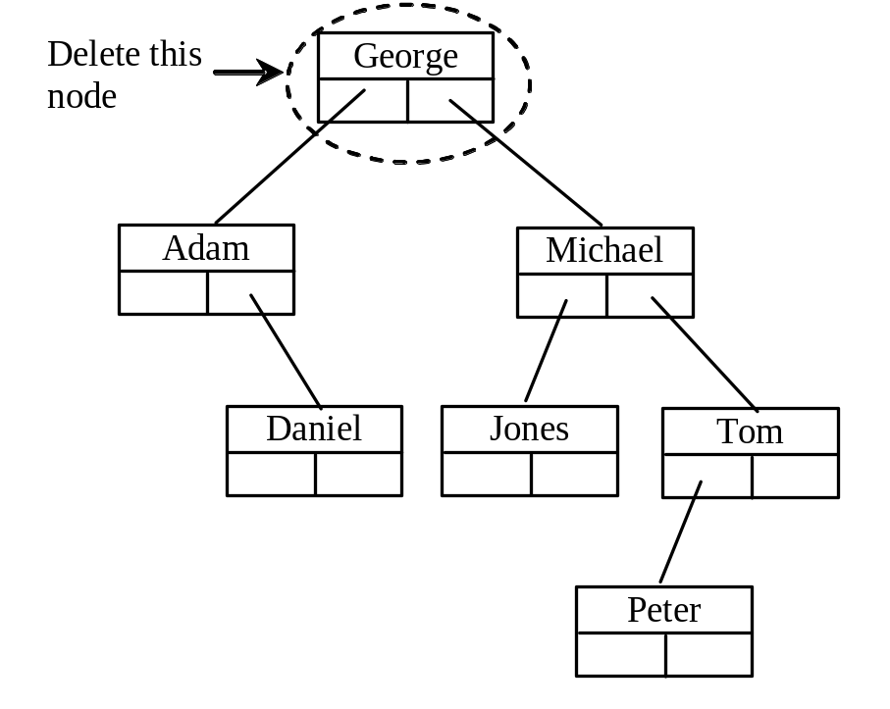
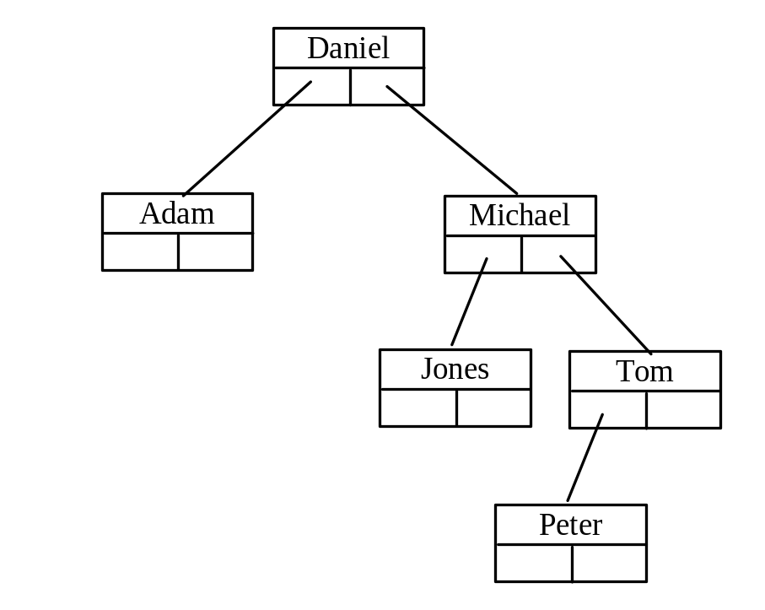
Examples

Slide 46
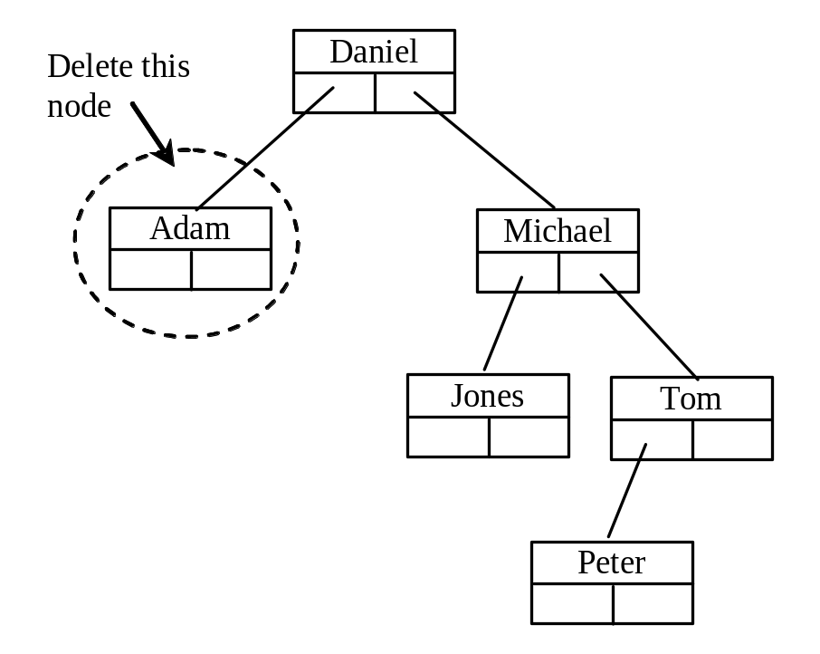
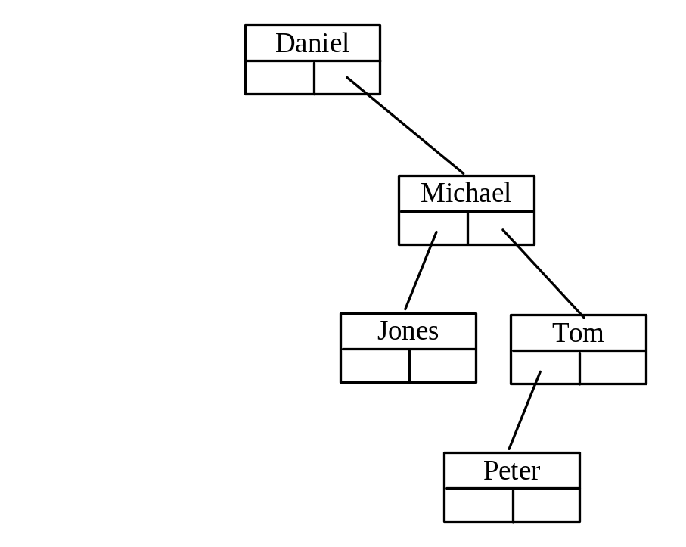
Examples

Slide 47
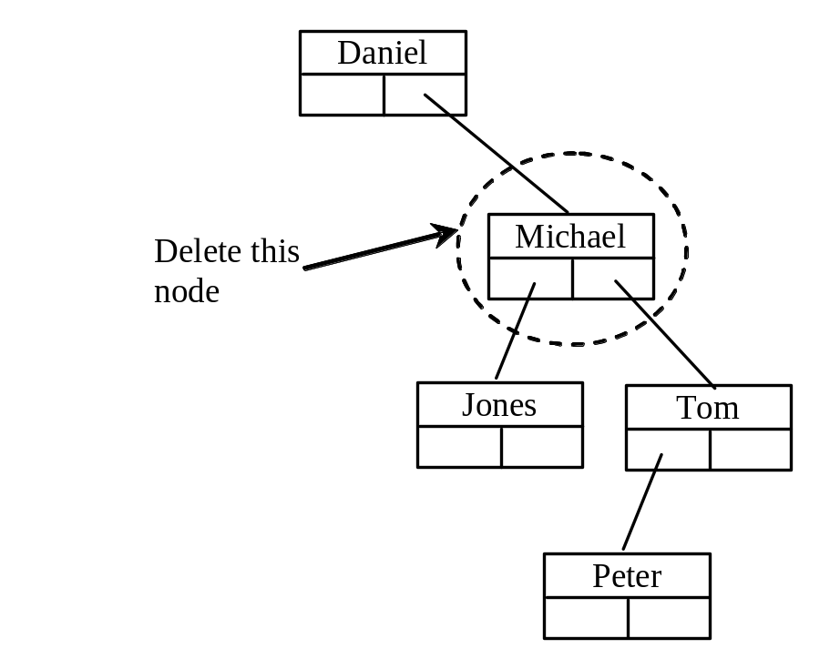
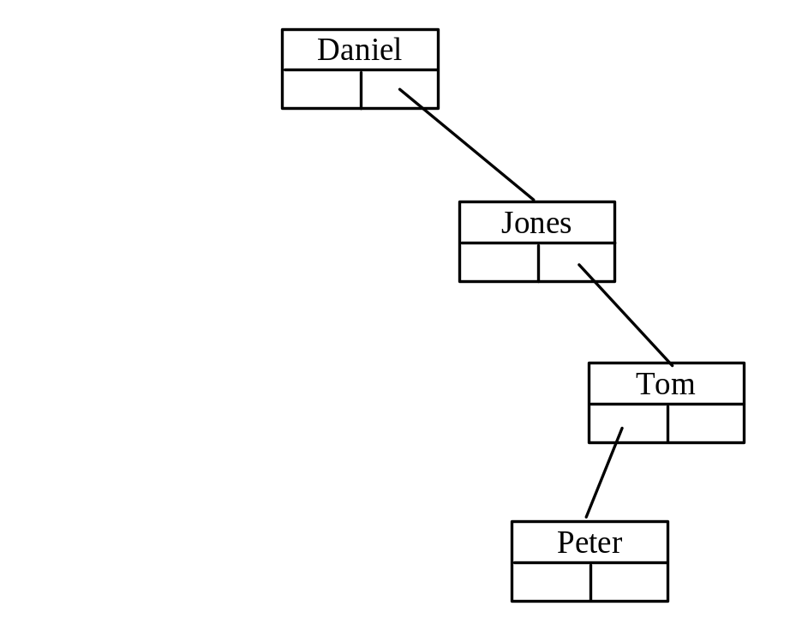
Examples
TestBinaryTreeDelete
Run

Slide 48
Additional Note: Deletion
First, locate the node to be deleted.
There are four possible cases when we delete a node
  The node to be deleted has no children. In this case, all we need to do is delete the node.
  The node to be deleted has only a right subtree. We delete the node and attach the right subtree to the deleted node’s parent.
  The node to be deleted has only left subtree. We delete the node and attach the left subtree to the deleted node’s parent.
  The node to be deleted has two subtrees. It is possible to delete a node from the middle of a tree, but the result tends to create very unbalanced trees.
Data Structures: A Pseudocode Approach with C, Second Edition

Slide 49
Delete node that has two subtrees
This can be done in one of two ways:
  Find the largest node in the deleted node’s left subtree and move its data to replace the deleted node’s data
  Find the smallest node on the deleted node’s right subtree and move its data to replace the deleted node’s data.
Principles:
  Move data from a leaf or a leaflike node that can then be deleted.
  The moves preserve the integrity of the binary tree.
Data Structures: A Pseudocode Approach with C, Second Edition

Slide 50
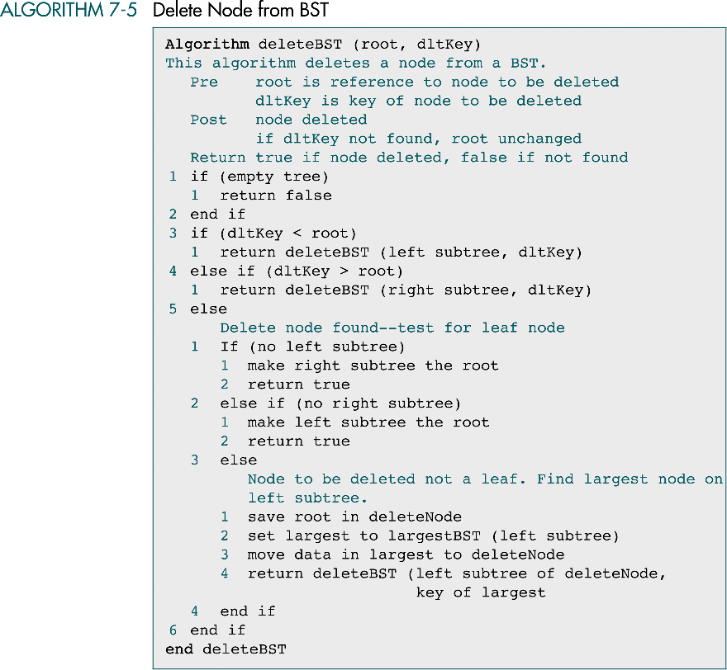
Data Structures: A Pseudocode Approach with C, Second Edition

Slide 51
(continued)
Data Structures: A Pseudocode Approach with C, Second Edition

Slide 52
binary tree time complexity
It is obvious that the time complexity for the inorder, preorder, and postorder is O(n), since each node is traversed only once. The time complexity for search, insertion and deletion is the height of the tree. In the worst case, the height of the tree is O(n).

Slide 53
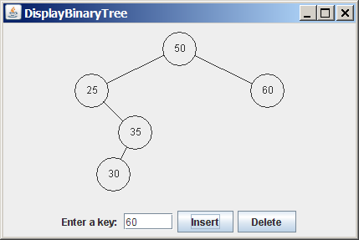
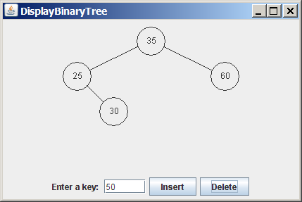
Tree Visualization
DisplayBinaryTree
TreeControl
Run

Slide 54
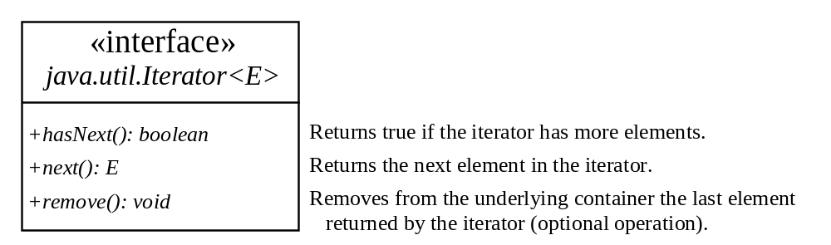
Iterators
An iterator is an object that provides a uniform way for traversing the elements in a container such as a set, list, binary tree, etc.
TestBinaryTreeWithIterator
Run

Slide 55
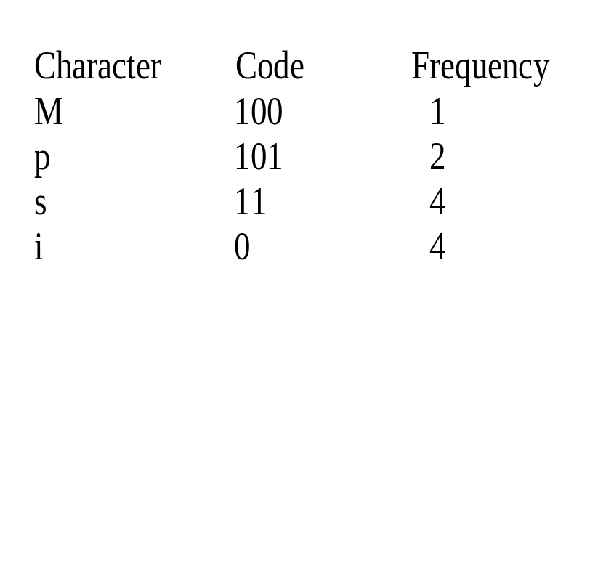
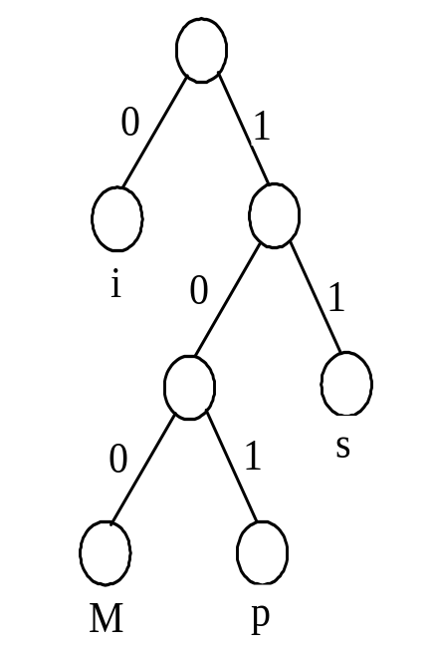
Data Compression: Huffman Coding
In ASCII, every character is encoded in 8 bits. Huffman coding compresses data by using fewer bits to encode more frequently occurring characters. The codes for characters are constructed based on the occurrence of characters in the text using a binary tree, called the Huffman coding tree.

Slide 56
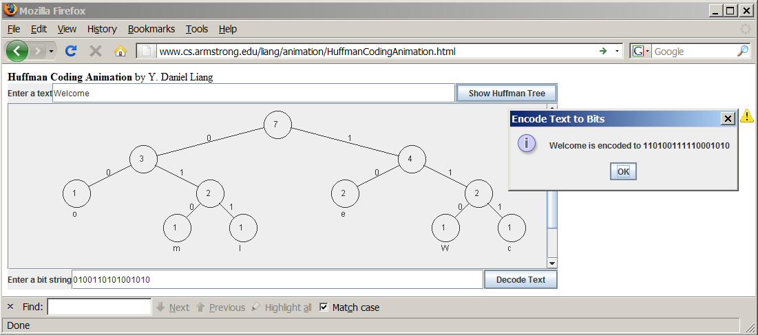
See How a Binary Tree Works
www.cs.armstrong.edu/liang/animation/HuffmanCodingAnimation.html

Slide 57
Constructing Huffman Tree
To construct a Huffman coding tree, use a greedy algorithm as follows:
Begin with a forest of trees. Each tree contains a node for a character. The weight of the node is the frequency of the character in the text.
Repeat this step until there is only one tree:
Choose two trees with the smallest weight and create a new node as their parent. The weight of the new tree is the sum of the weight of the subtrees.

Slide 58
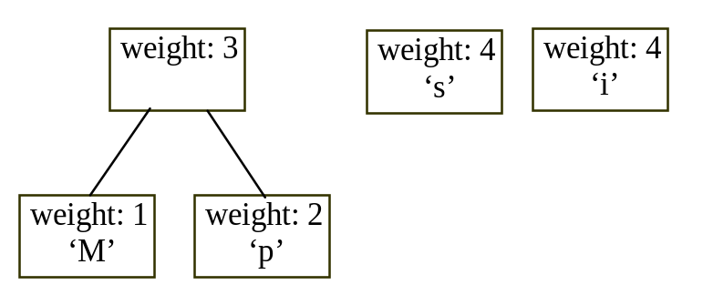
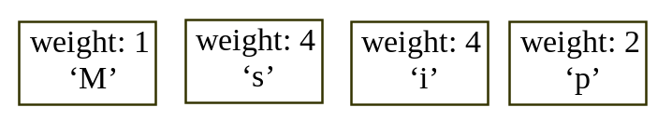
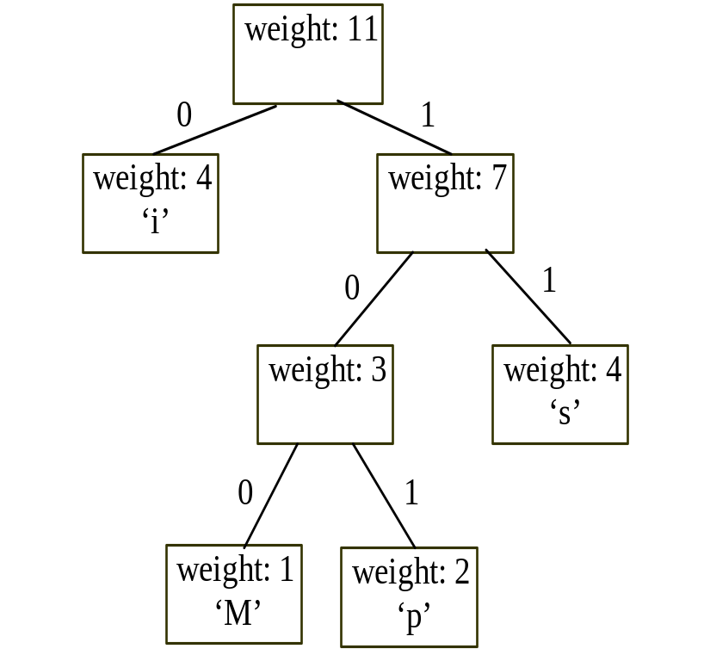
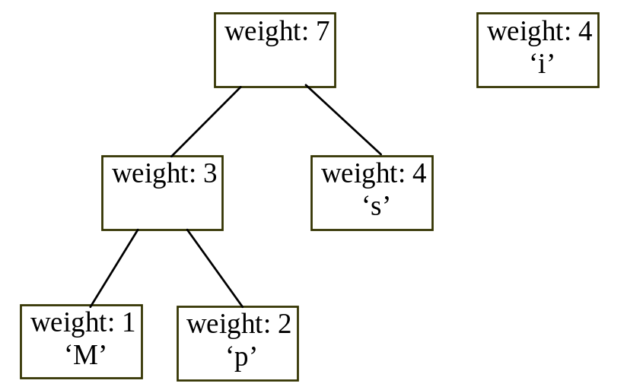
Constructing Huffman Tree

Slide 59
Constructing Huffman Tree
HuffmanCode
Run

